Slide 1
Condition Monitoring Techniques in the Wind Industry
Daryl Hickey - Natural Power
BINDT CM2020
Date: 14.06.2021

Slide 2
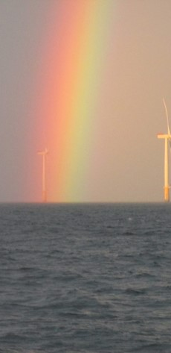
What is Condition Monitoring?
Condition Monitoring
ISO 13372:2012⁽¹⁾ defines Condition Monitoring (CM) as;
‘The detection and collection of information and data that indicate the state of a machine’.
CM techniques, sometimes referred to as Predictive Maintenance (PM) are proven in the industry to provide major improvements to plan and asset reliability.’
Reliability incorporates historical failures, repair and downtime, these can be measured in terms of availability.
Drivetrain components are the most frequent and most expensive components to repair. It is widely thought that 10% of all major component failures can be attributed to the gearbox alone

Slide 3
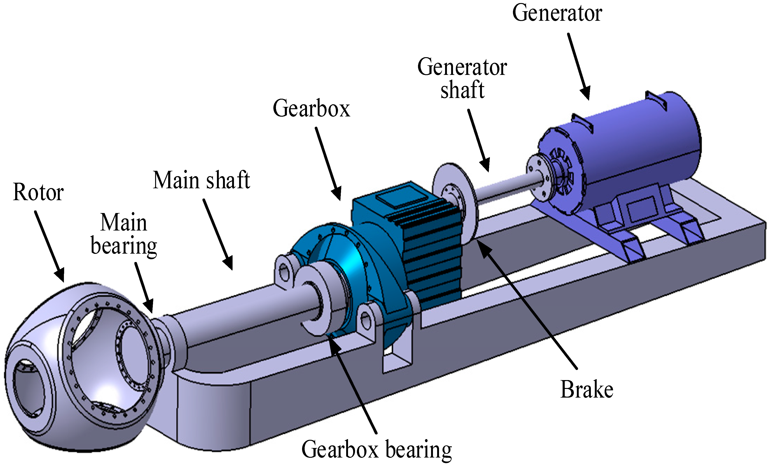
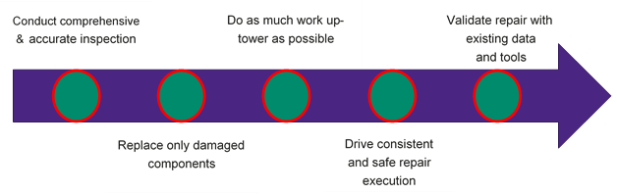
Why do we need monitoring?
Condition Monitoring
The drivetrain of a Wind Turbine Generator (WTG) is composed of the
Main bearing
Main shaft
Gearbox
Brake
High speed coupling
Generator shaft
Generator (including generator bearings).

Slide 4
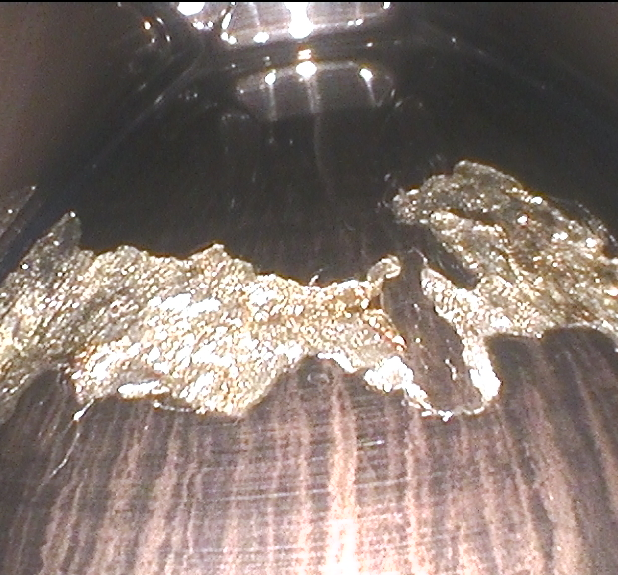
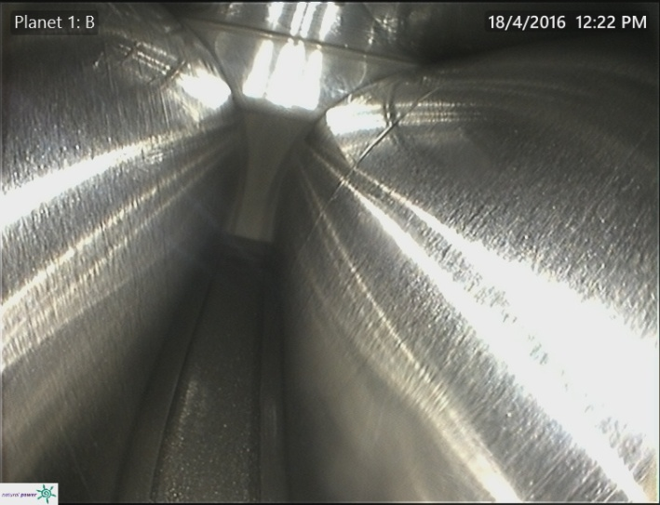
Why do we need monitoring?
Condition Monitoring
Planet Bearing
Loss of Material
Subsurface initiated fatigue
  Hertzian Theory
    Microcracks
    Flaking
    Spalling
    Peeling
Planet Bearing
  Normal Abrasive Wear
Clean Oil Film
Normal abrasion lines running in direction of rolling contact

Slide 5
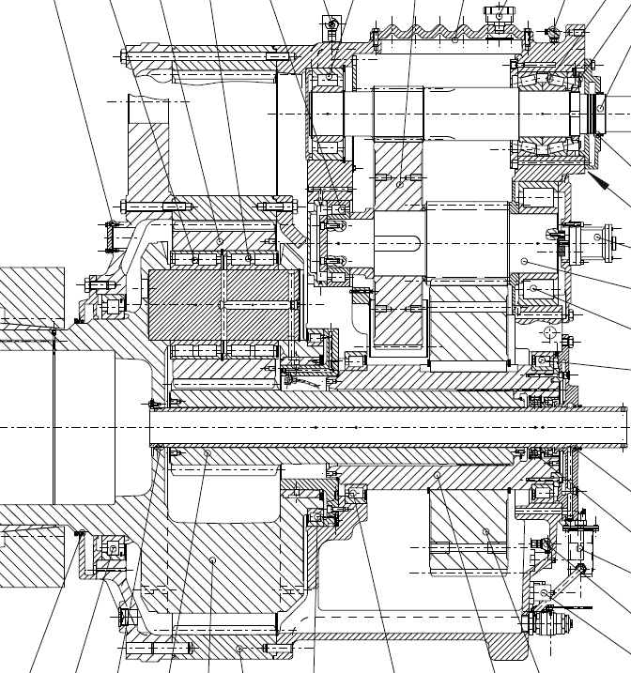
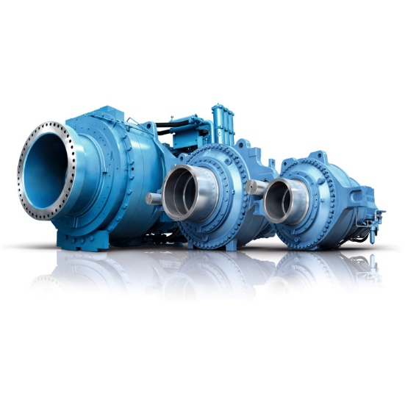
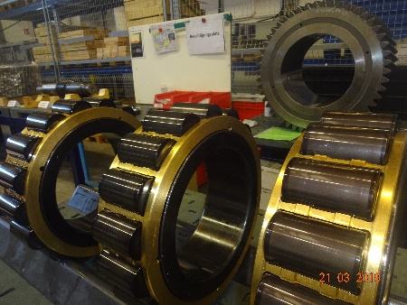
Independent CMS, vibration trend analysis
The most common remote monitoring systems are SCADA, tribology and Vibration Monitoring:
Other techniques include Ultrasound and Thermography
  Collectively known as a Condition Monitoring System (CMS)
SCADA offers an excellent approach for analysis of low frequency signals
  Temperatures, pressures, particle count, current, shaft speeds
Vibration monitoring provides a superior method of damage detection, albeit at a higher cost (computational and financial)
  Damage can be pin-pointed
  Classical well developed mathematical methods e.g. the Fast Fourier Transform (FFT), enveloping, wavelets
  The rotational nature of the drivetrain lends itself nicely to being able to mathematically determine events per cycle

Slide 6
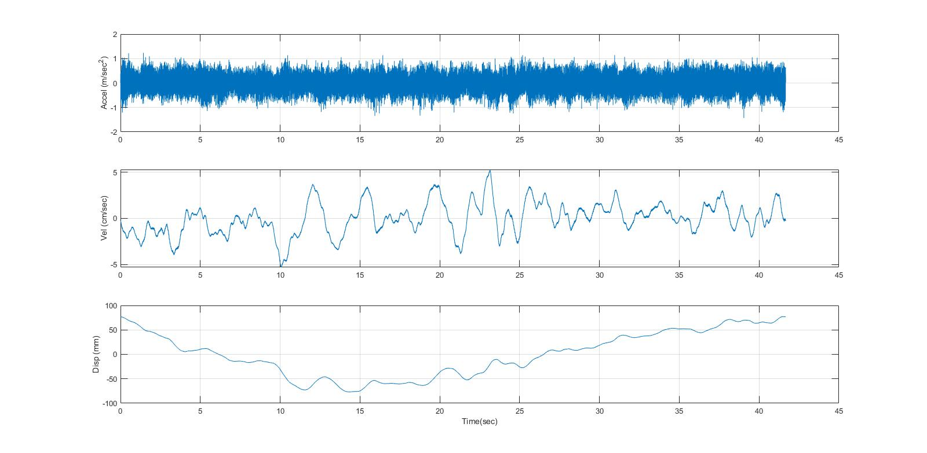
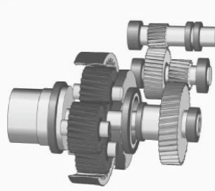
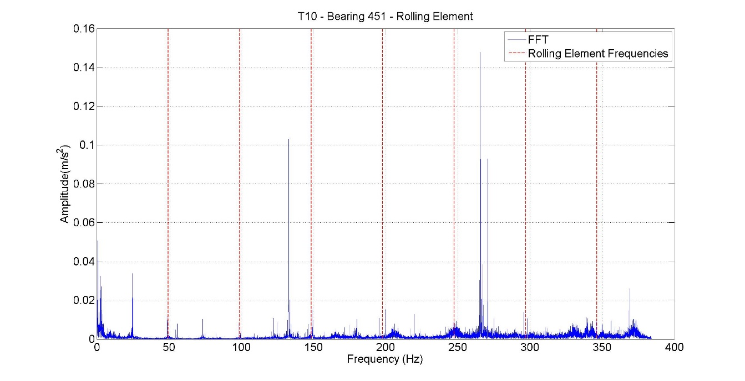
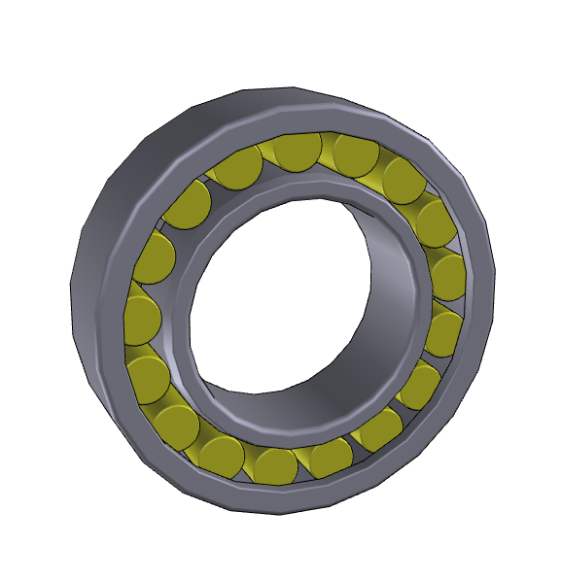
Independent CMS, vibration trend analysis
Measure the time series
Use Fourier Transform to get the frequency content
  Interested in how many times something happens per second or per revolution
Cross Reference with our calculations

Slide 7
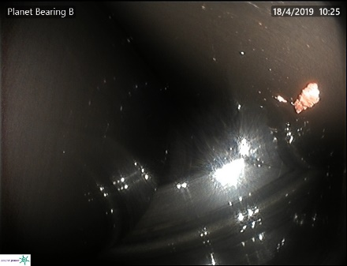
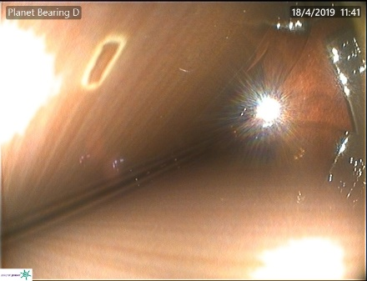
CMS, vibration trend analysis
Damage identification at of a rolling element damage and planetary bearings
Verified by inspections
Early detection to inform site maintenance activities and proactive repairs where possible

Slide 8
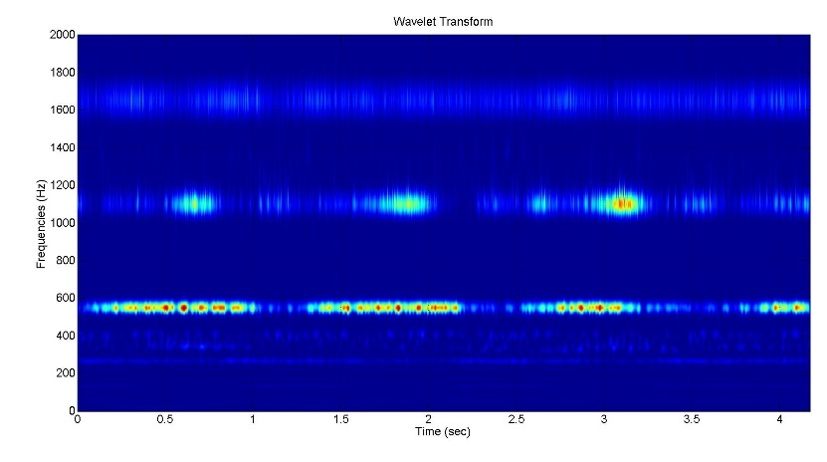
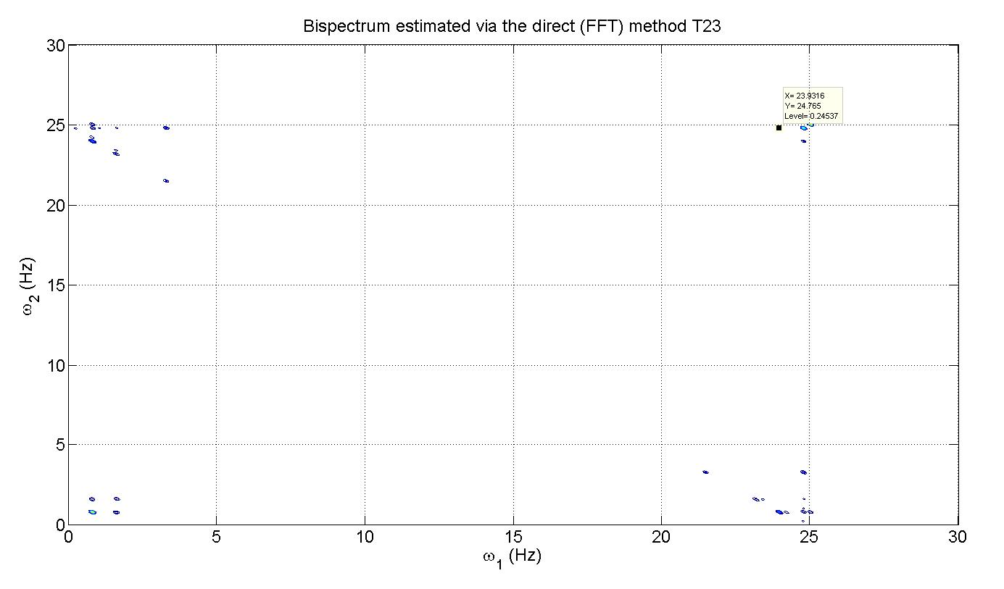
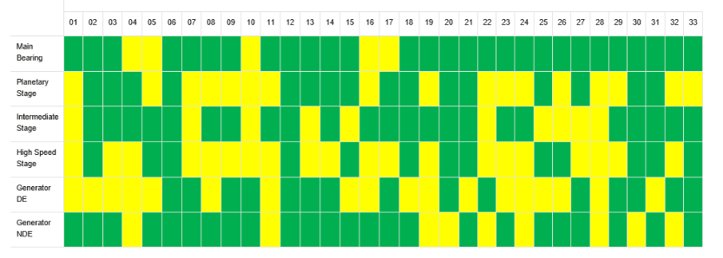
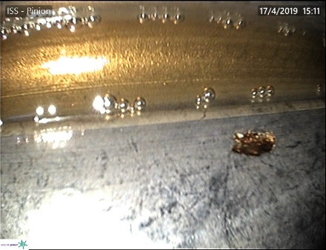
Independent CMS, vibration trend analysis
Damage detection can also be performed by frequency variation analysis
Intermediate shaft damage with low speed
Damage identified on four turbines and claimed under warranty due to NP analysis

Slide 9
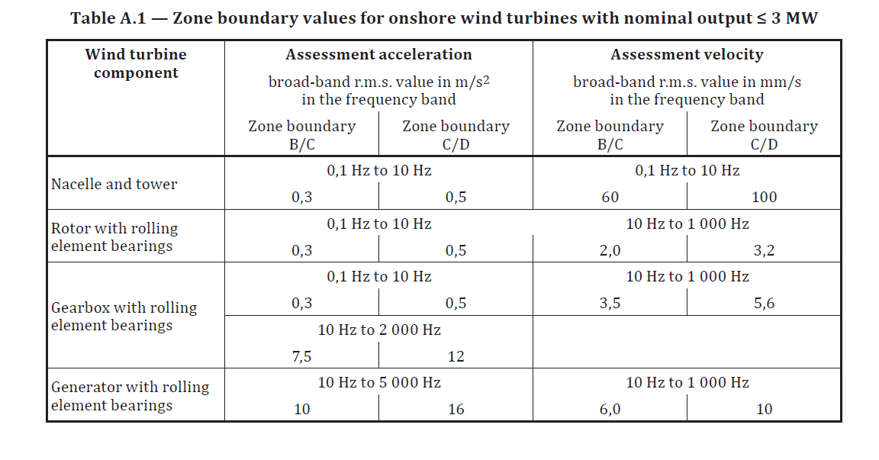
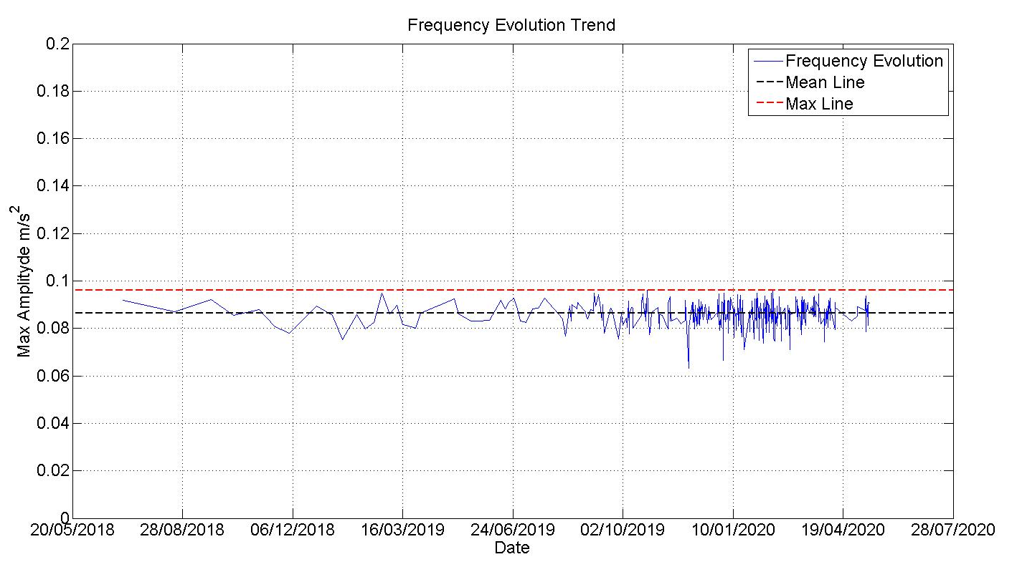
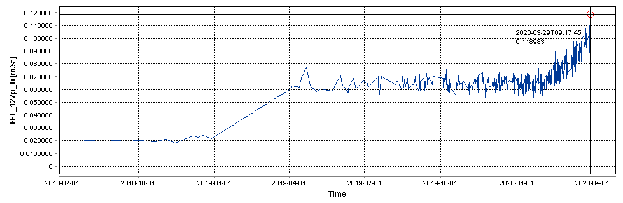
Independent CMS, vibration trend analysis
When do we raise an alert?
Track known frequencies over time
Benchmark against mean levels
Industry Standards are a guide
Site knowledge and experience within APE team
Increasing trends raise alert
Case Study
Costly replacement could have been avoided

Slide 10
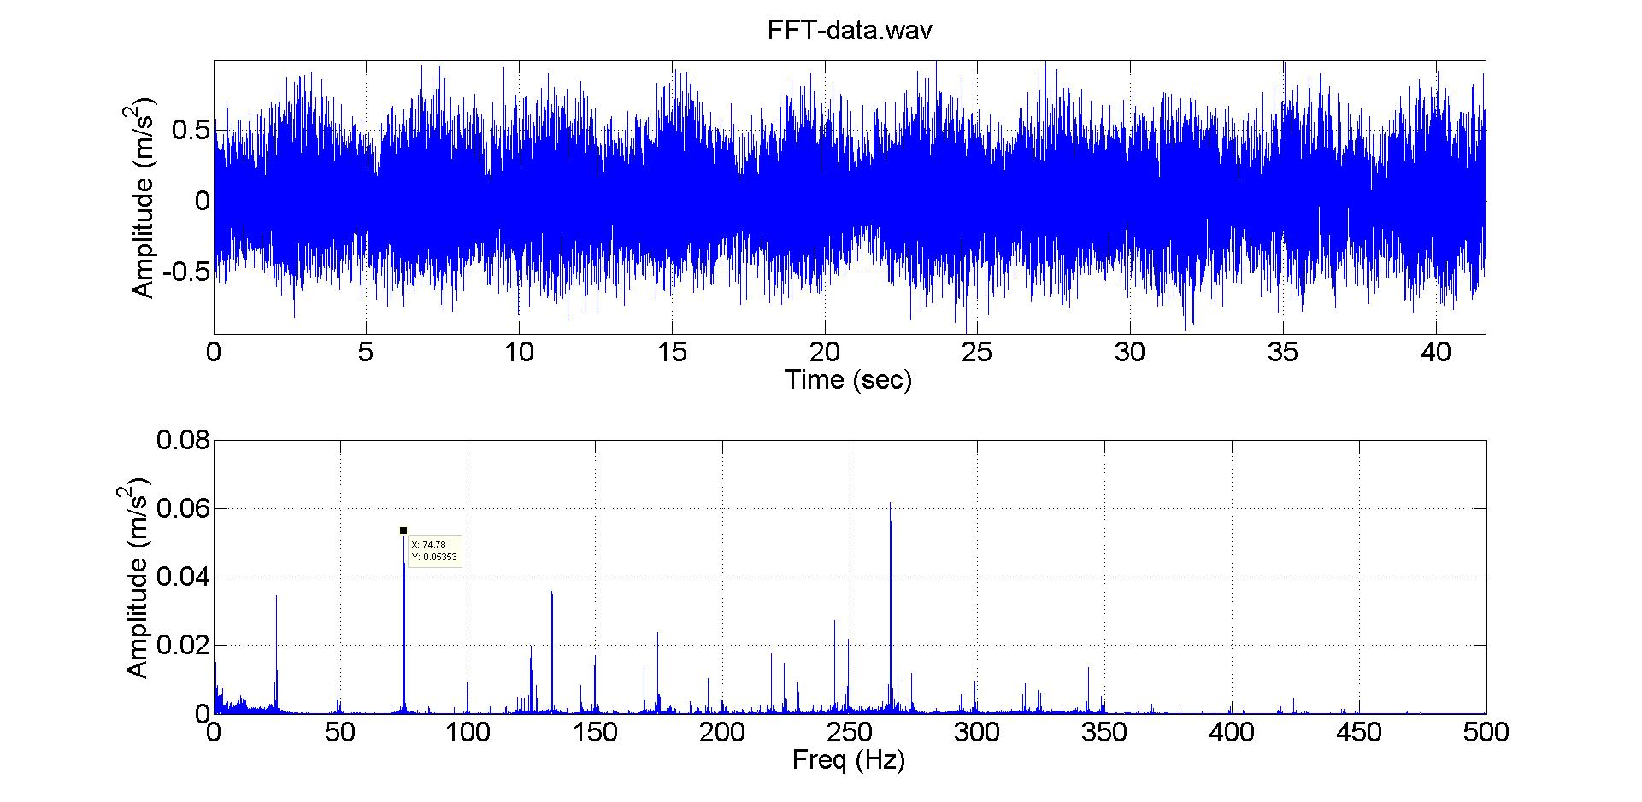
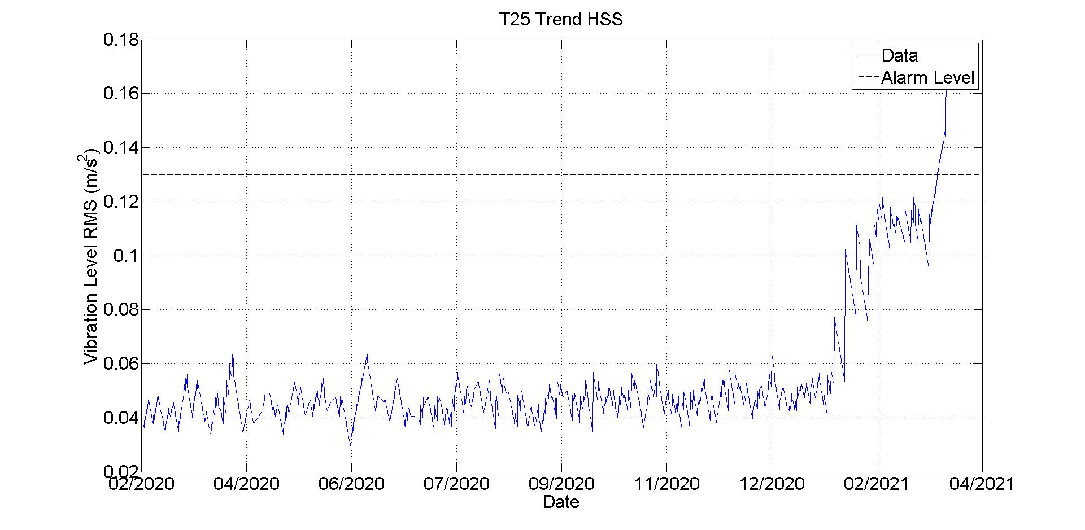
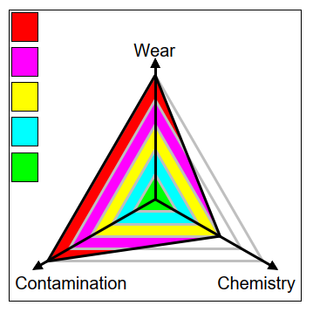
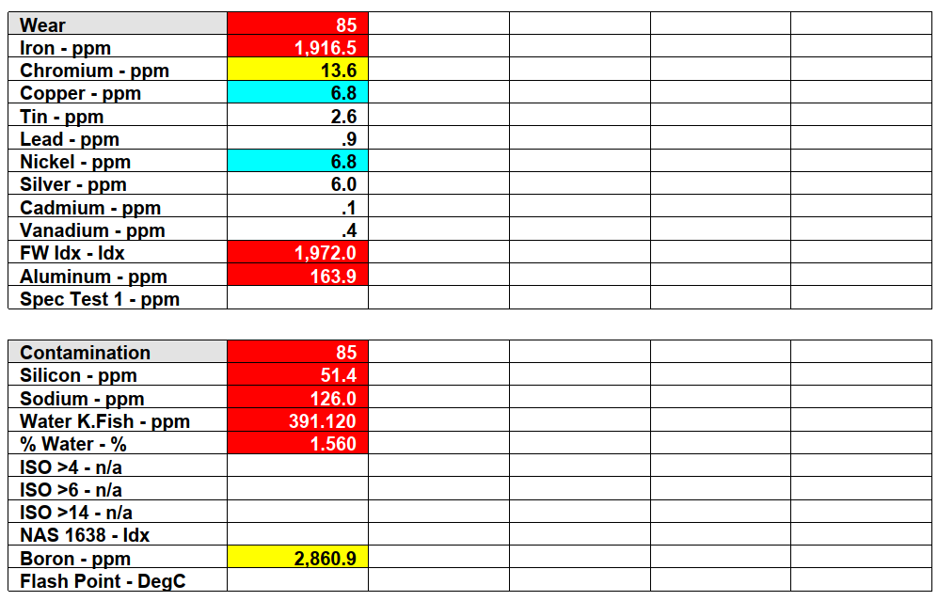
Alarms
CMS Alarms were causing WTG to shut down.
Data Analysis revealed several trends relating to the HSS inner race
These vibration patterns were observed to have been rising in energy levels over a short period of time
Lubrication Samples had returned as alarming

Slide 11
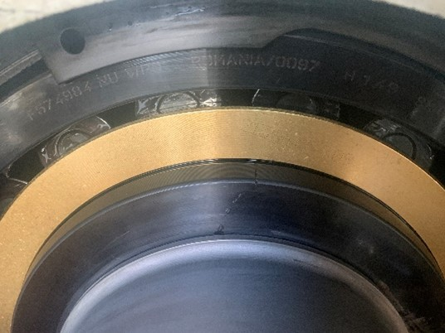
Inspection
The Natural Power Inspection team mobilised to site to further investigate.
As part of the investigations, the team uncovered inner race cracks consistent with the frequencies found in the data analysis
This damage is considered severe and unrepairable and an exchange was necessary in accordance with relevant ISO standards and site experience.
Due to the location the repair could be carried out up-tower removing the necessity for expensive crane hire.
Finding this crack also prevented secondary damage to the coupling or the generator. Secondary damage prevention also removed any future requirement for crane hire.

Slide 12
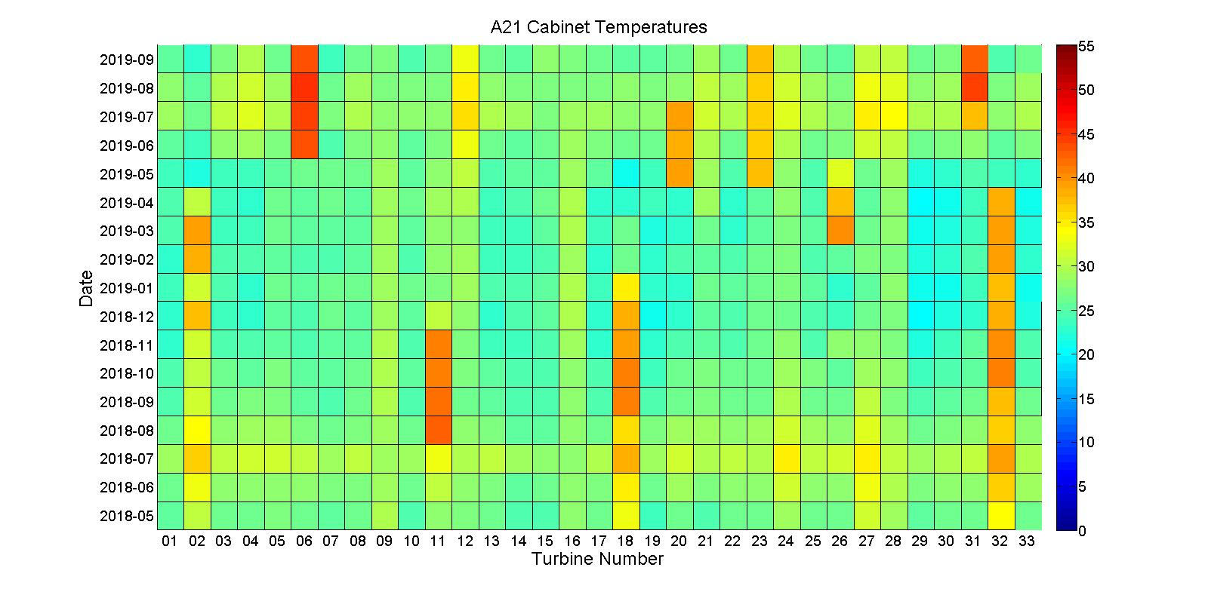
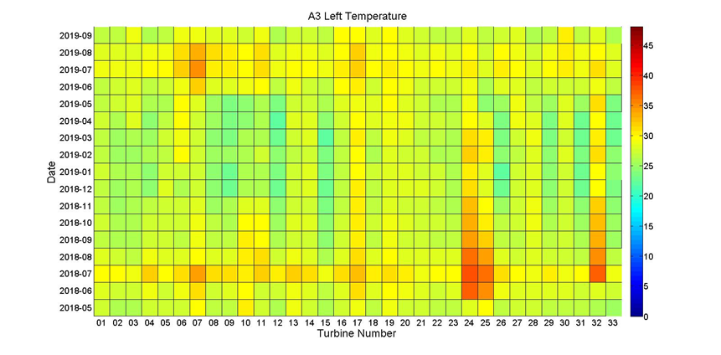
Sometimes it’s just a fan – NP Monitoring
Independent CMS, vibration trend analysis
SCADA Case Studies
Understand the kinematic maths of Fan Issue
Change at next visit
Cost of fan ~ £20
Cost of exchange of cabinet ~ £k
Sometimes it’s the brakes – NP EOW
Yaw brakes failing
Brake Dust
Component exchange at next visit
Cost of exchange of brakes ~£00’s
Cost of exchange of yaw gear ~ £ks

Slide 13
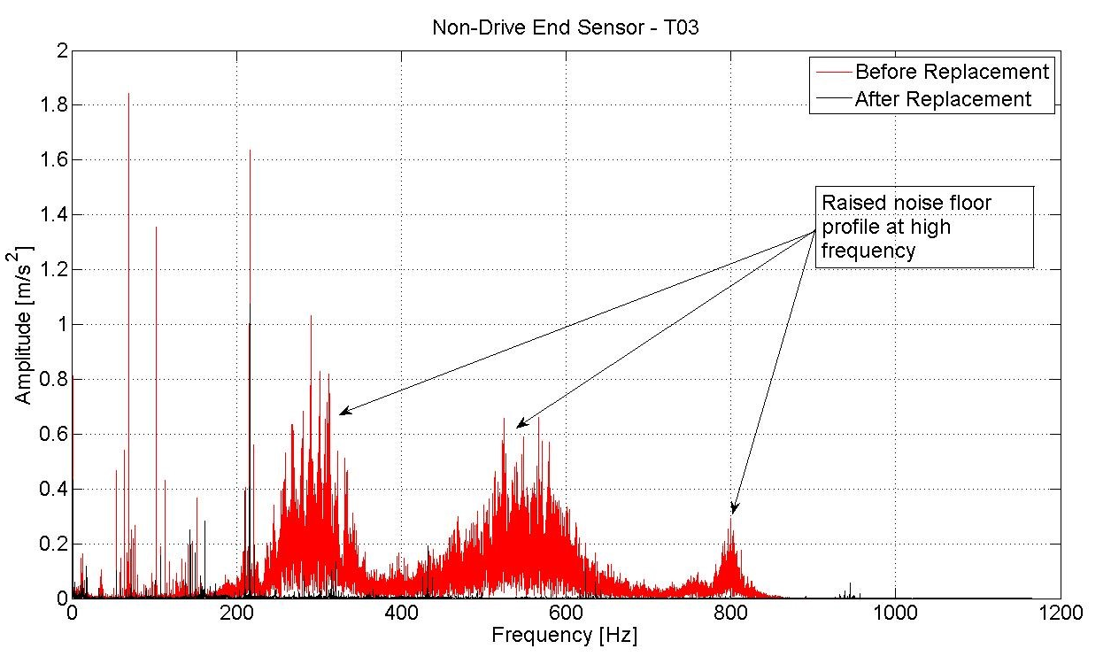
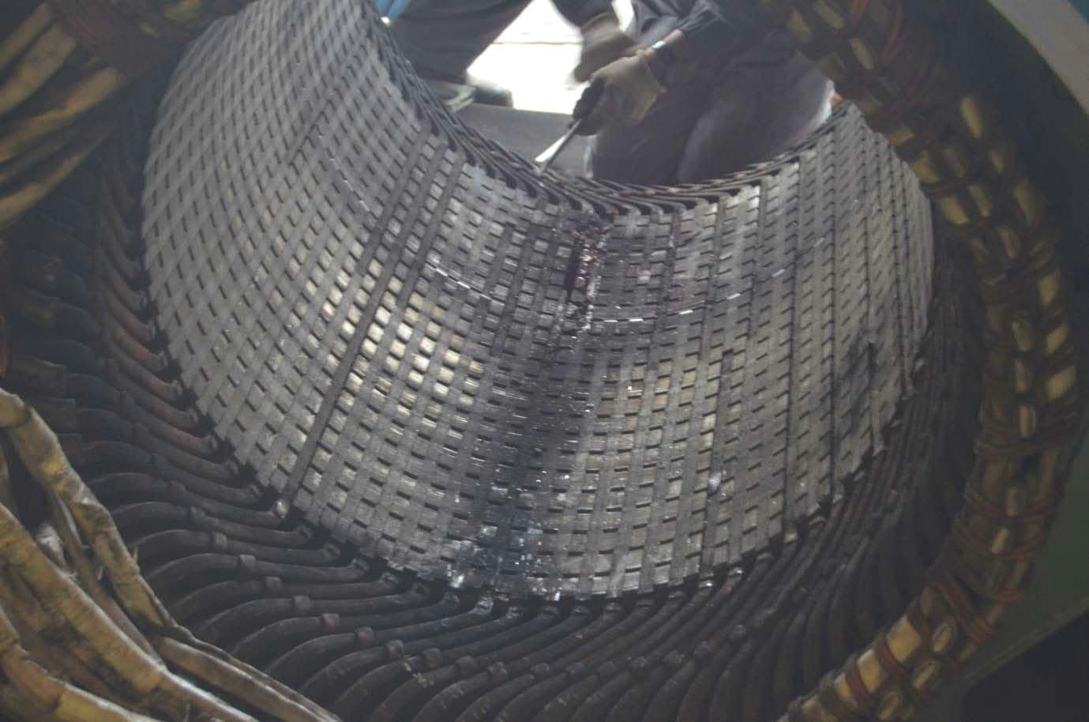
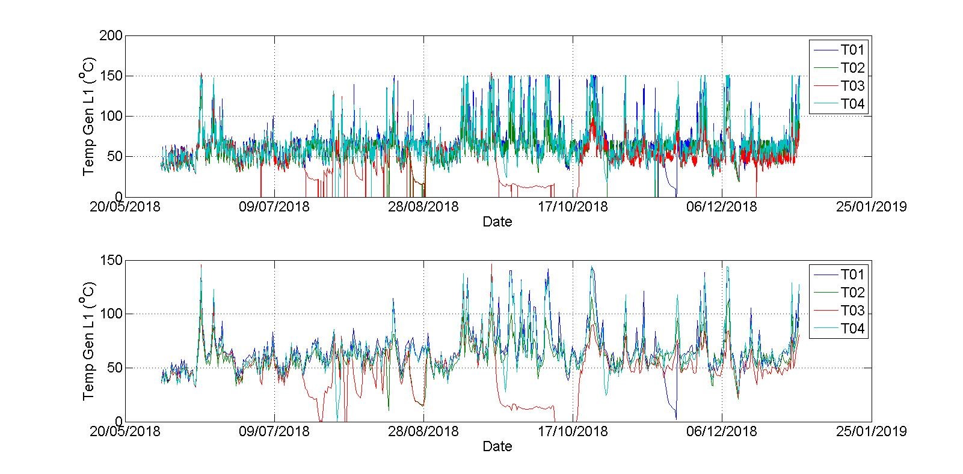
Additional case studies
Generator rotor frequency anomaly due to generator bearing misalignment
High temperature signals identified insulation degradation
IMS fault detection and novel inspection approach to verification
Gearbox serial defect flagging through fleet analysis

Slide 14

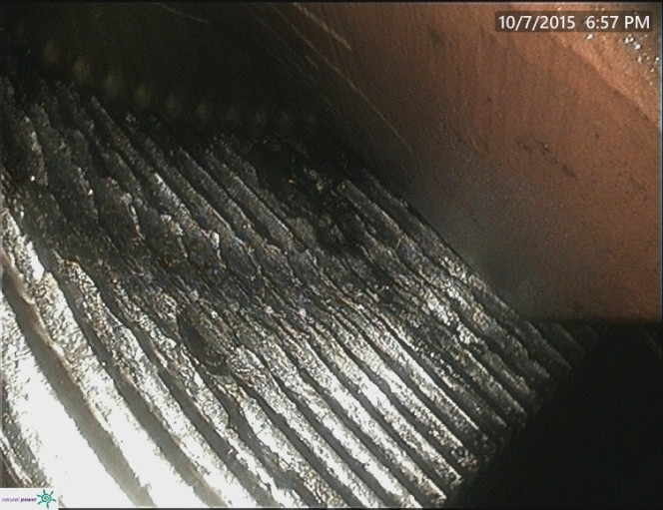
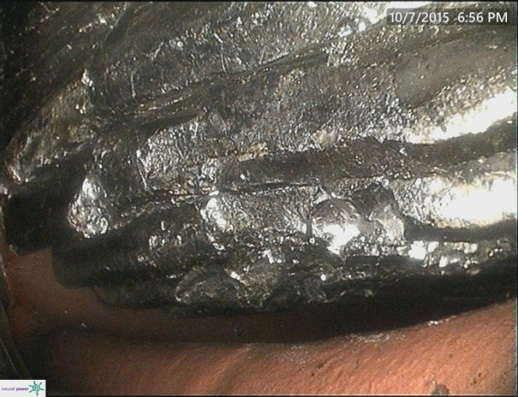
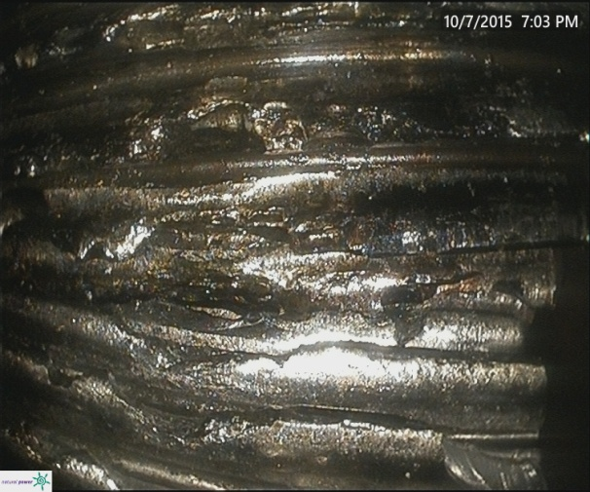
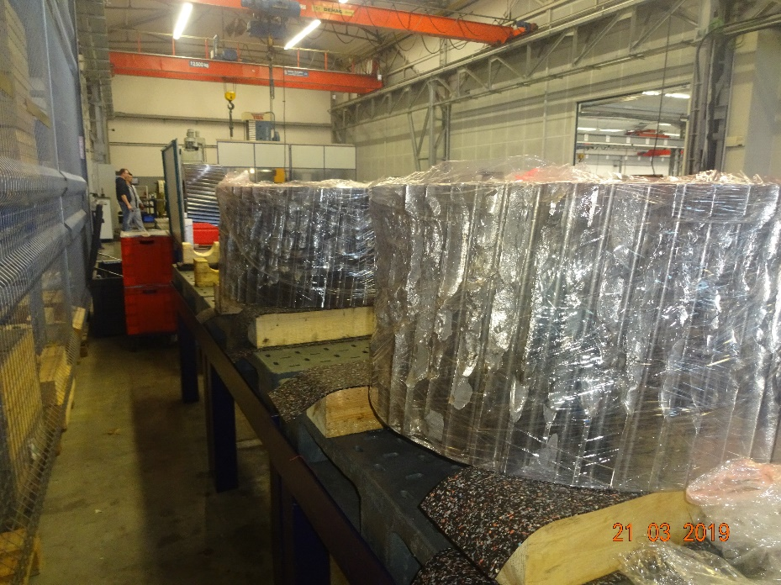
Condition Monitoring
When we get here it is too late
Understand the kinematic maths of rotating gears and bearings
Use software skills to process the data
Follow industry standards
Attempt to avoid crane costs
Assist the site team in implementing predictive maintenance

Slide 15
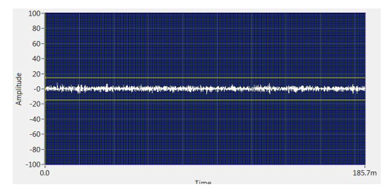
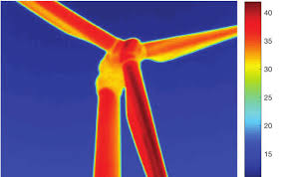
Further Techniques
Ultrasound and Thermography
Ultrasound
For rotating components, e.g. bearings, industry best practices and experience provides the following guidelines when analysing ultrasonic data:
  An 8 dB gain over baseline indicates pre-failure or lack of lubrication.
  A 12 dB increase establishes the very beginning of the failure mode.
  A 16 dB gain indicates advanced failure condition
  A 35-50 dB gain warns of catastrophic failure.
  Thermography
  The study of emissivity
  Excellent for detection of hotspots, electrical issues, electrical resistance leakage

Slide 16
Conclusion
Industry approach
  Important to use multiple analysis
  Detect, identify and quantify with multiple approaches
  Continual monitoring with sophisticated signal processing algorithms to assist with damage detection and categorisation of faults
  A combination of drive-train vibration data with SCADA improves the likelihood of detecting potential failures
Owner Benefits
  Confidence in health of fleet
  Minimise downtime
  Uncover damage patterns prior to these becoming critical, provide the ability to repair rather than downtime and replace prior to damage escalation and secondary damaged effects
  Additional data collection for analysis for performance and life extension analysis

